Slide 1

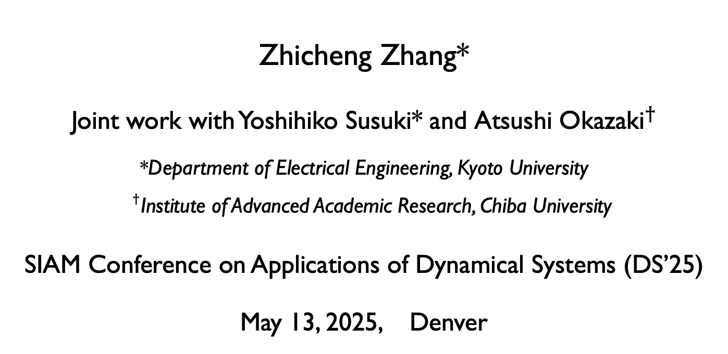
Koopman Analysis of Large-Scale Transient Simulation Data on Weather Dynamics
Zhicheng Zhang*
Joint work with Yoshihiko Susuki* and ${\text{Atsushi} \text{Okazaki}}^{†}$
*Department of Electrical Engineering, Kyoto University
${}^{†}$Institute of Advanced Academic Research, Chiba University
SIAM Conference on Applications of Dynamical Systems (DS’25)
May 13, 2025, Denver

Slide 2
Purpose and Outline
Q1: Can we capture a dominant (e.g., transient) Koopman mode embedded in a large-scale and short-term simulation data?
Q2: Which types of pattern should we focus on?
Motivations and Previous Works
Data Source (Short-Time High-Dim. Weather Dynamics)
Methods (KMD, DMD, Sparsity-Promoting DMD)
Experiments on Different Observed Data Fields (Extract Transient Modes in Terms of Bubble-Like Patterns)
Summary

Slide 3
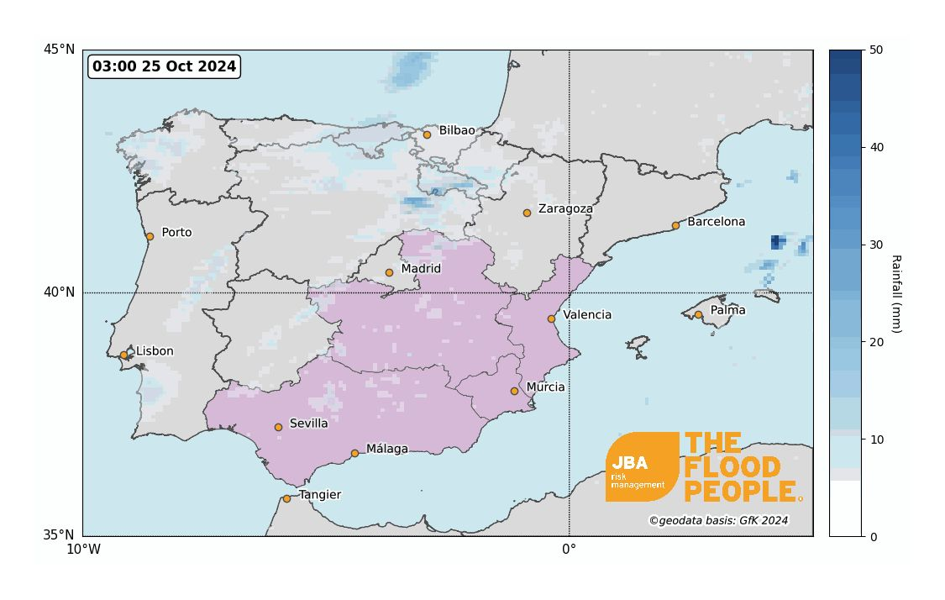
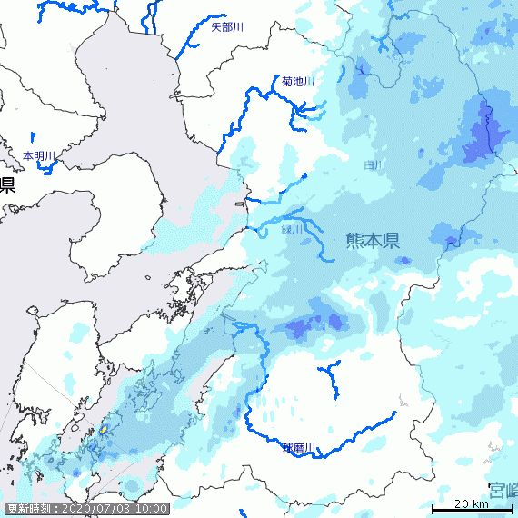
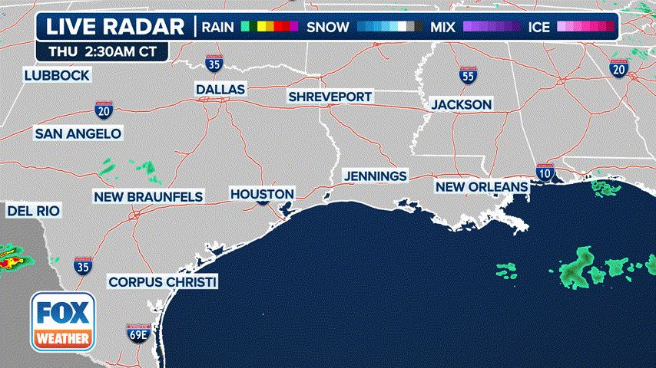
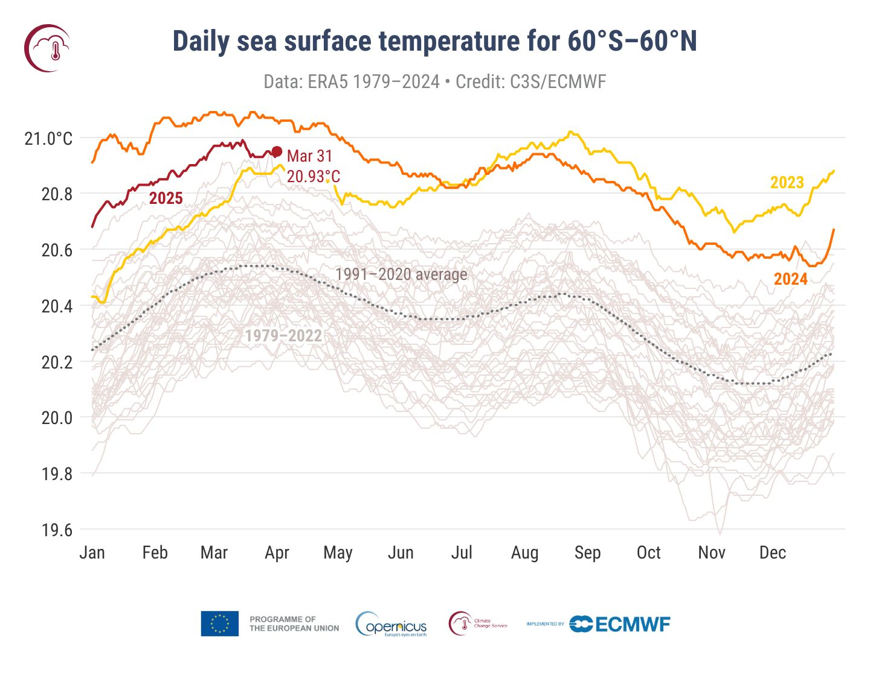
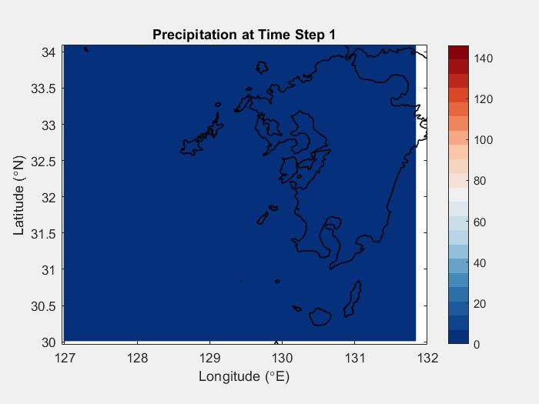
Heavy Rain-full Impacts: Floods, Climate Changes,…
A 3-hour radar loop showing where showers and thunderstorms are ongoing (Omega blocking pattern, Flood threat across Southeast, in these days…)
2024 Spanish floods Oct. (torrential rain caused by an isolated low-pressure)
2020 Kyushu floods (heavy rain of July)
“East Asian rainy season: Tsuyu”
Short-term Weather systems (Transient dynamics, e.g.,12-hours)

Slide 4
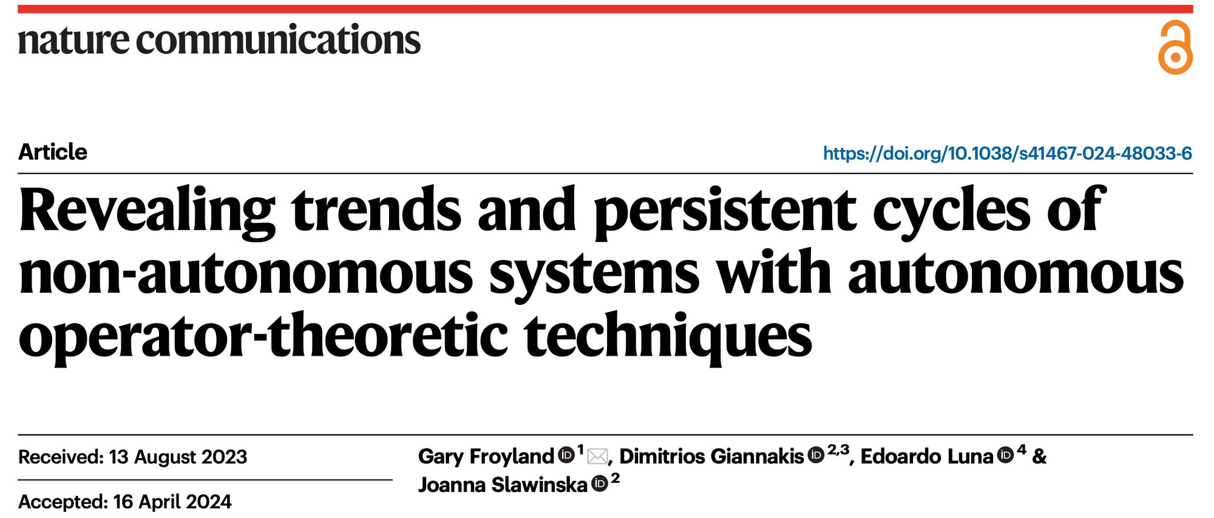

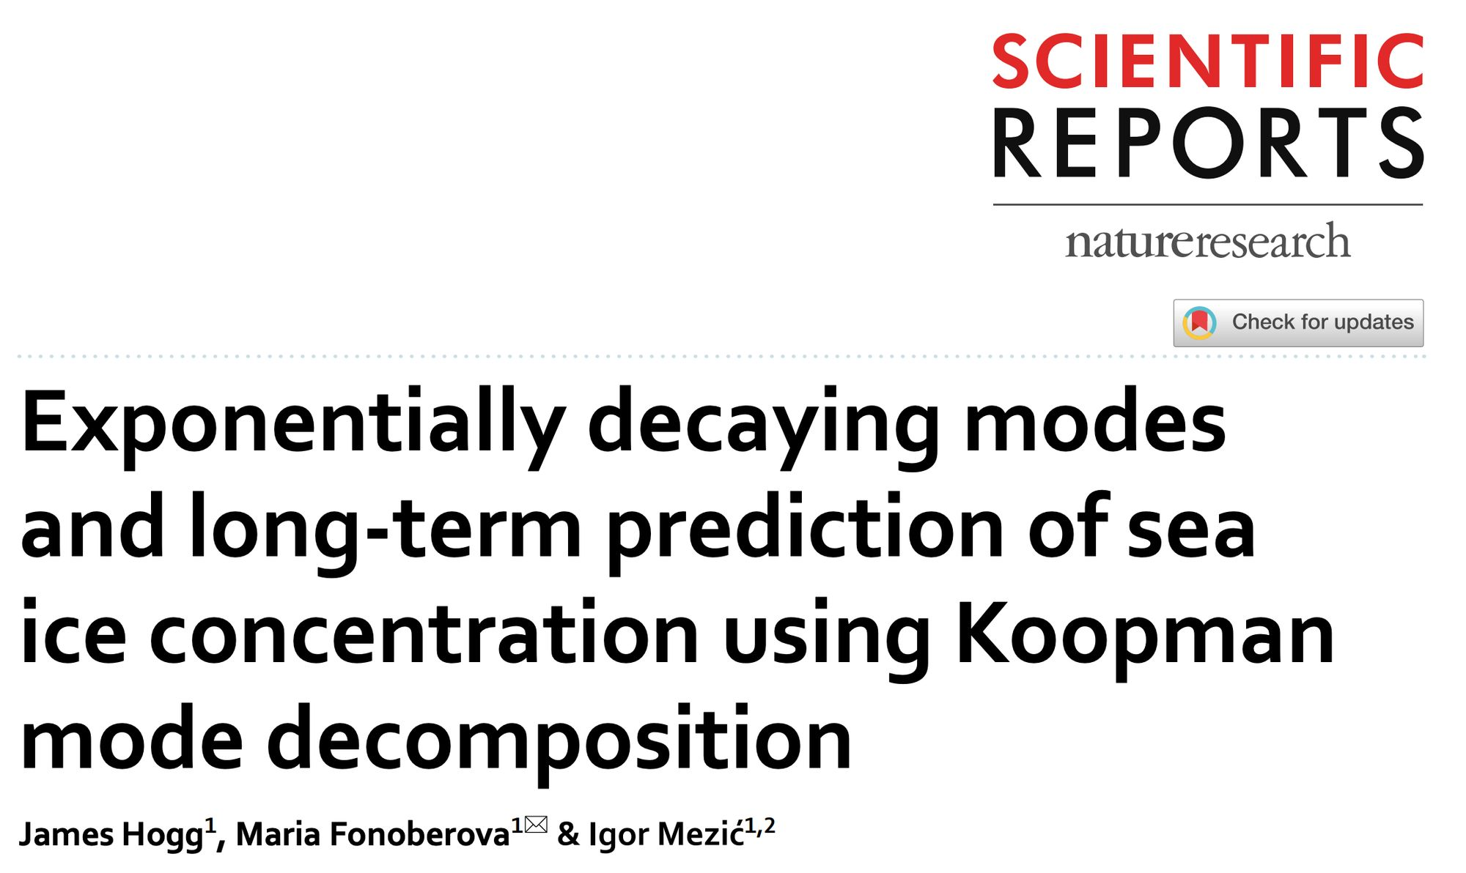
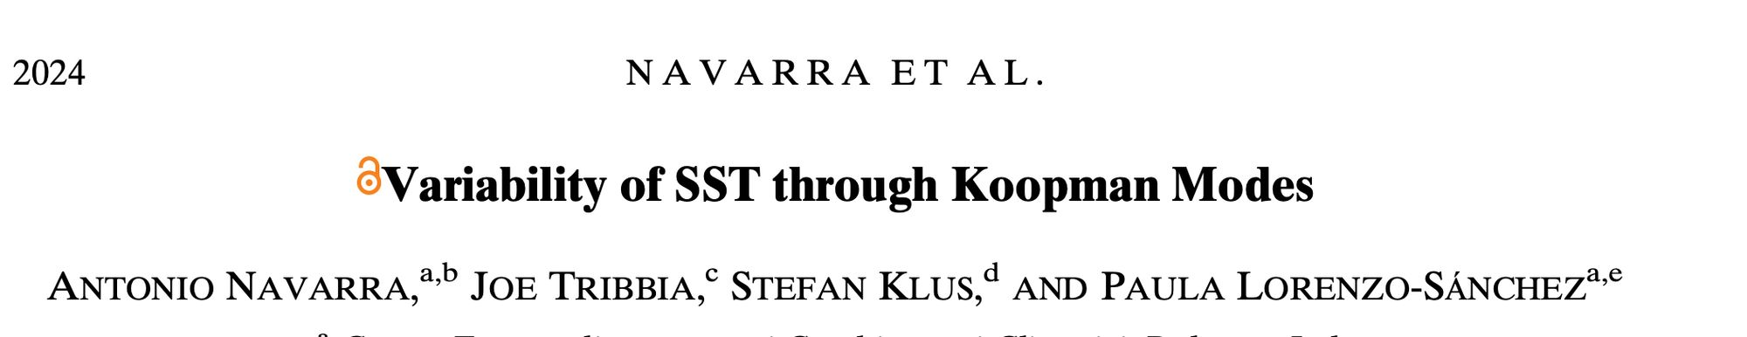
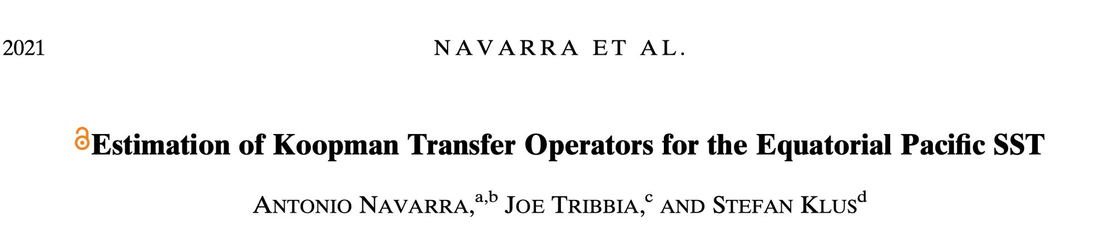
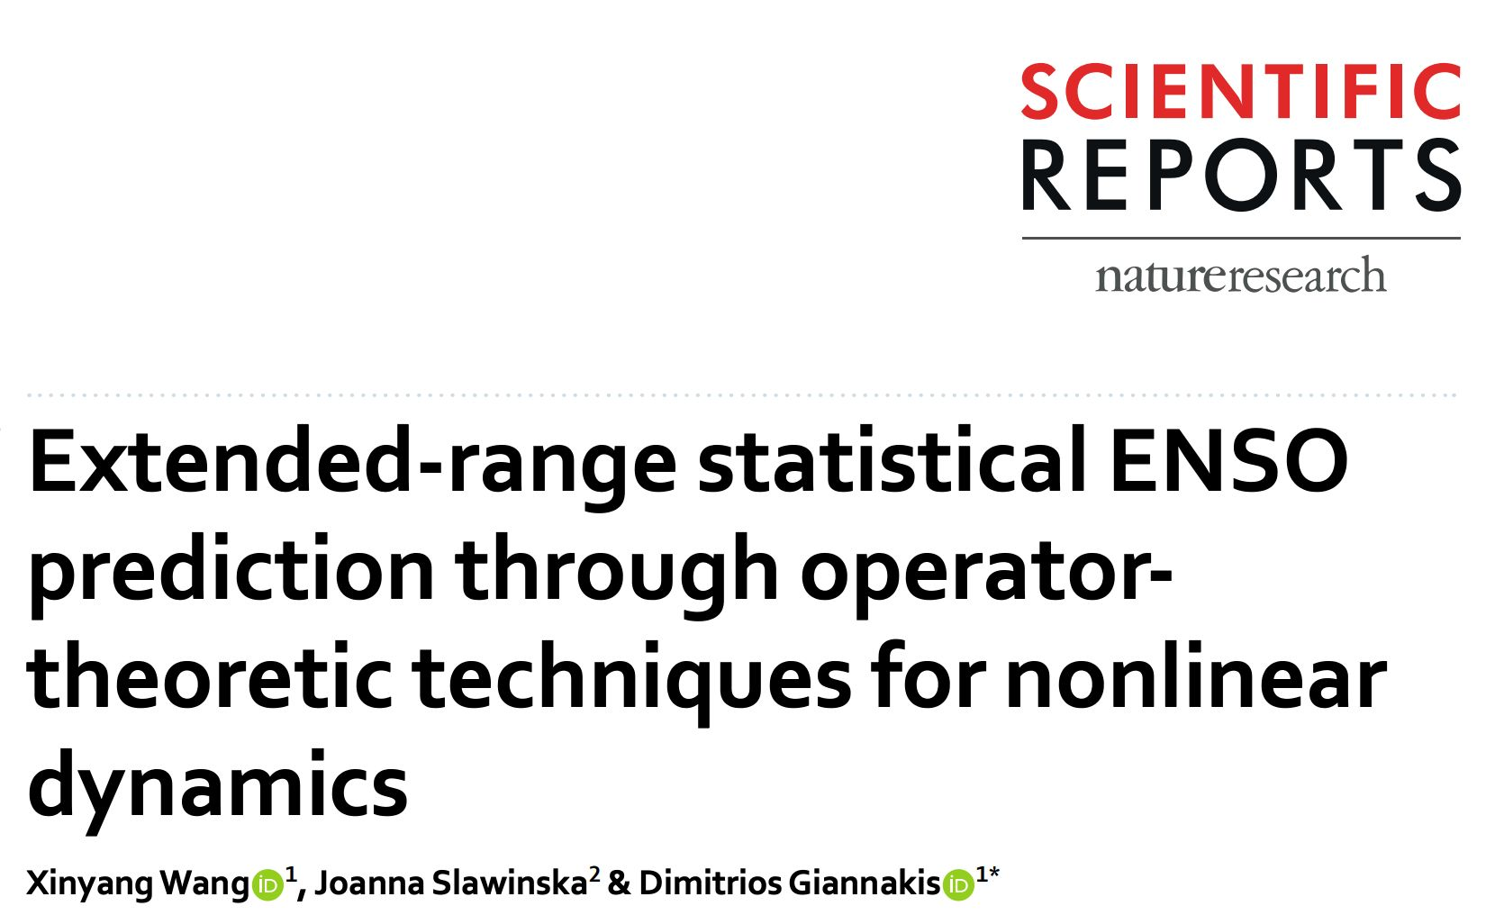
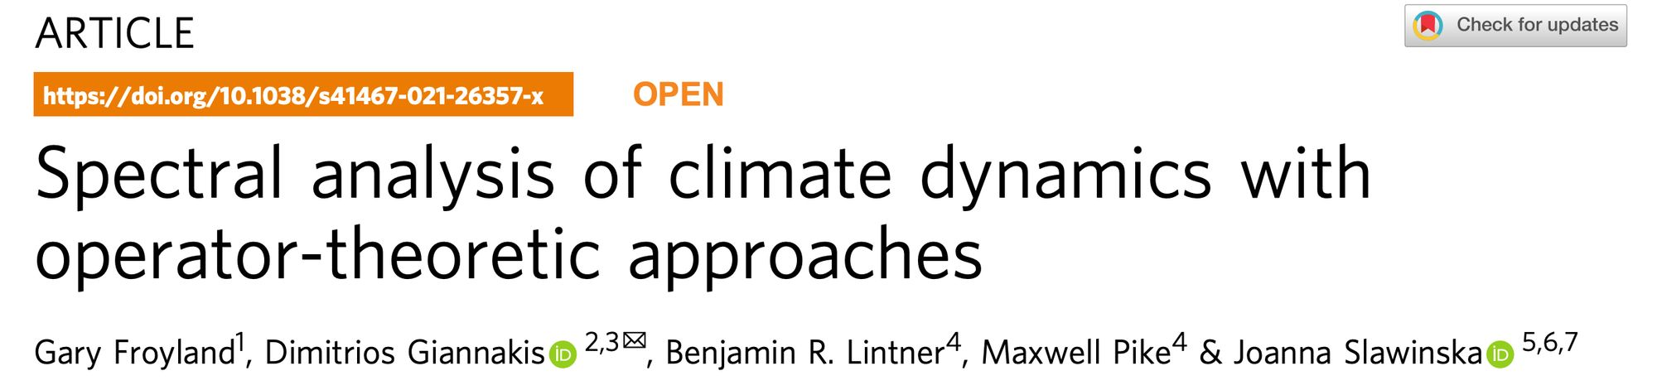
Previous Works on Climate or Weather Systems
However, fewer studies have focused on short-term weather systems, which are governed by transient dynamics.
……

Slide 5

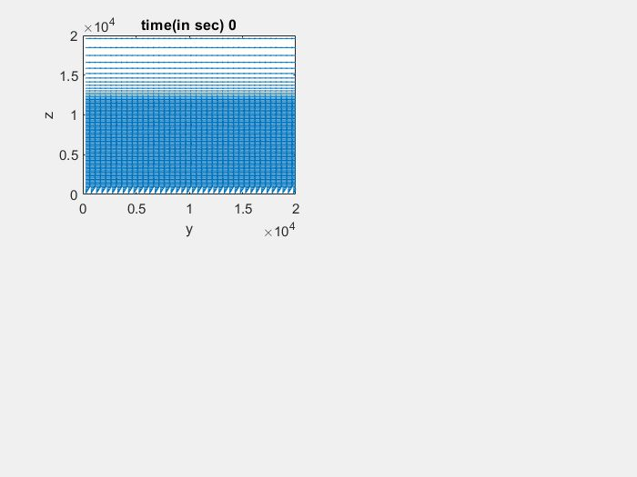



Data Source: SCALE Weather Simulation Data*
3D
$$z$$
2D
$$x$$
Vertical z-direction
(data.W)
Distance 20 km with 97 grids
$$z$$
$$y$$
$$y$$
$$x$$
Horizontal y-direction (data.V)
Distance 20 km with 40 grids
y-z plane:
40 x 97 = 3880 grids
SCALE Weather dynamics Simulation
Time unit: 30 sec. ( or 0.5 min) per iteration
Original data :
N=121 snapshots (1-hour) and 3880 grids
*Ref.) SCALE: Scalable Computing for Advanced Library and Environment, RIKEN, url: https://scale.riken.jp

Slide 6
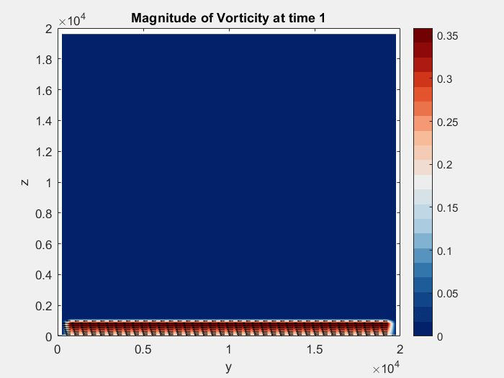
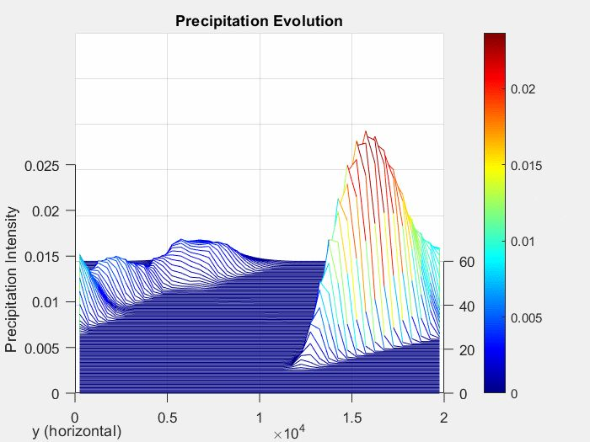
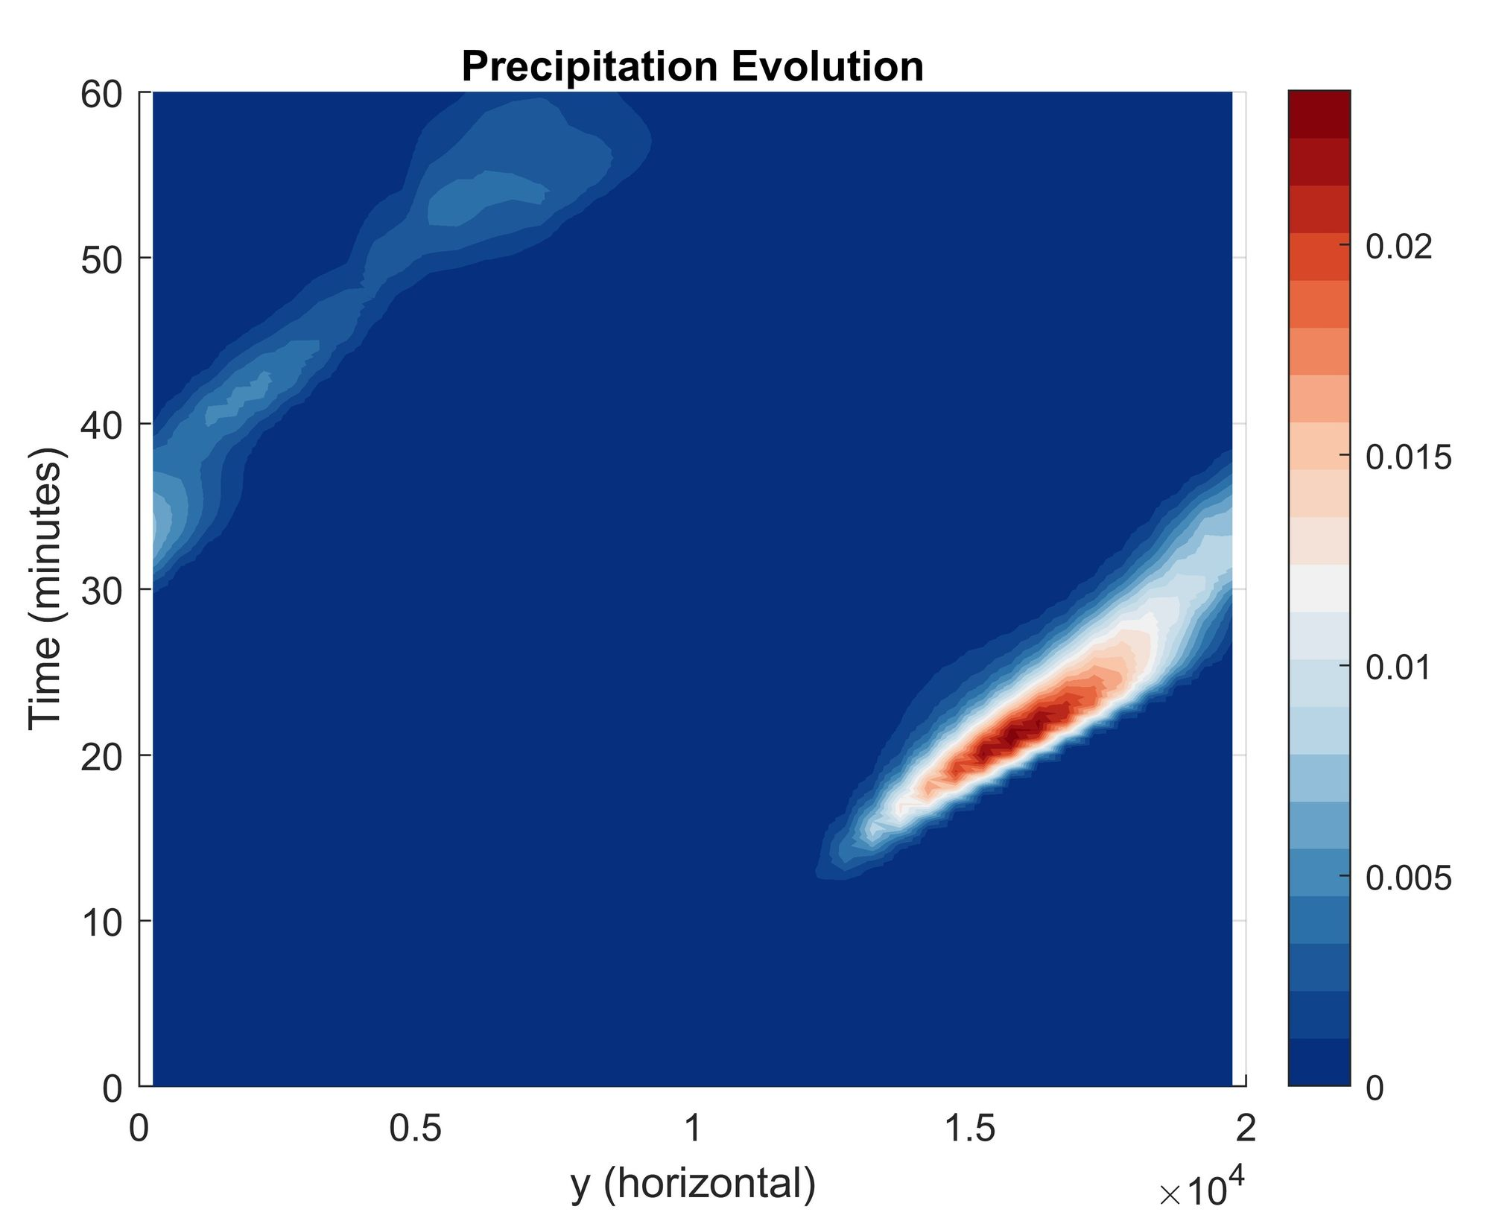
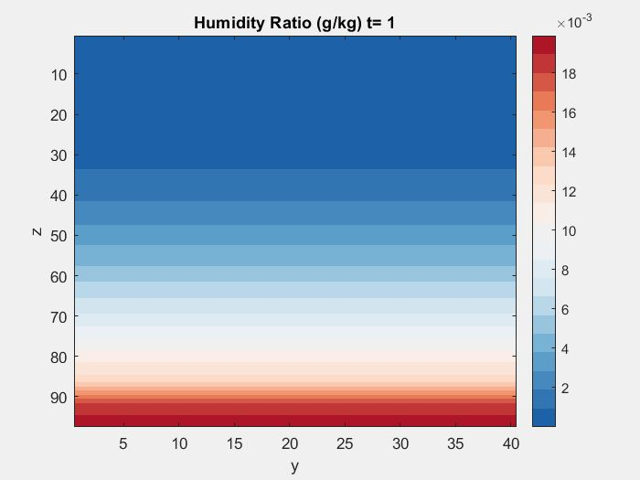
Data Fields: Vorticity Magnitude, Humidity Ratio, Precipitation
?:Warm bubble-like structure
Precipitation in 3D and 2D that is closely related to bubble-like structures
What we intend to do:
Extract dominant transient modes with ? structures from weather simulations across ‘different observable data spaces’ to reveal growth or decay of heavy rainfall (precipitation)

Slide 7
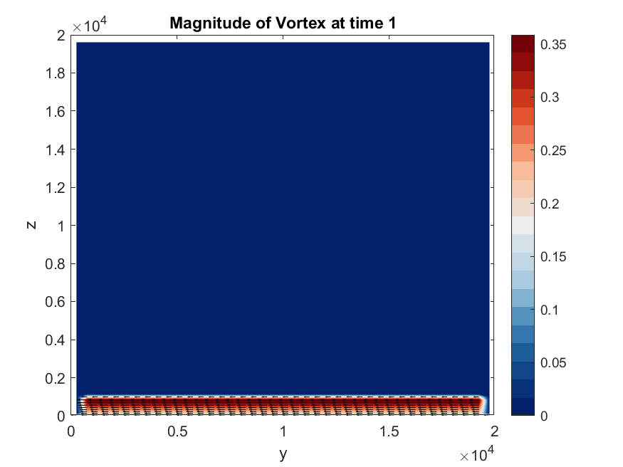
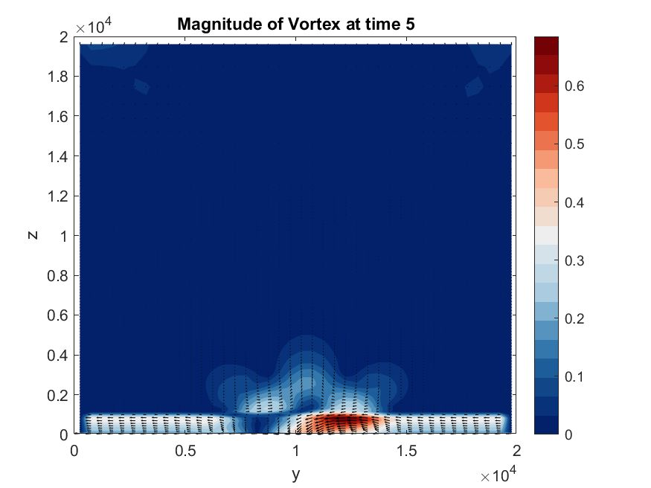
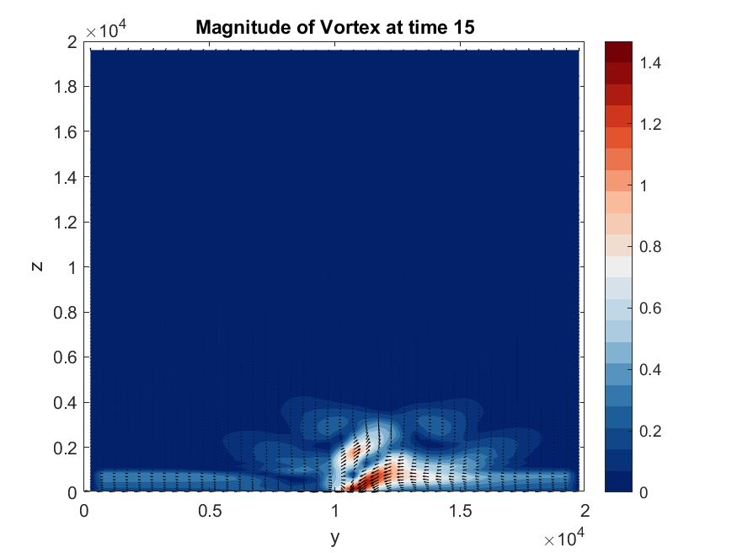
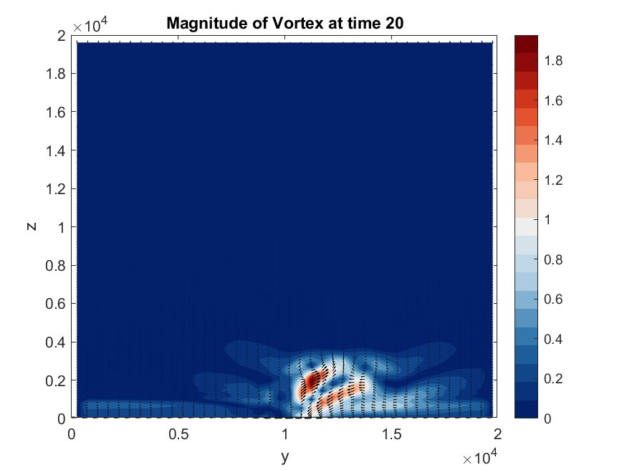
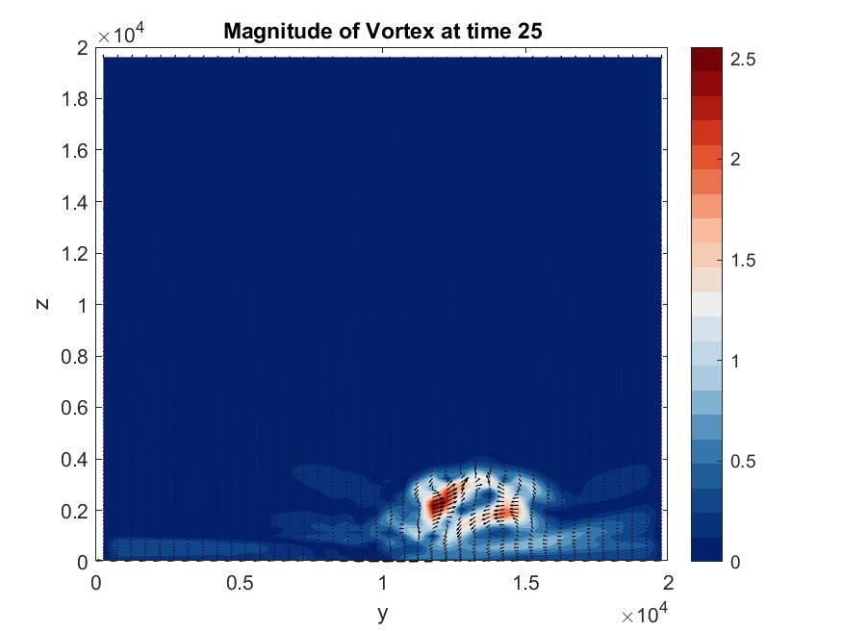
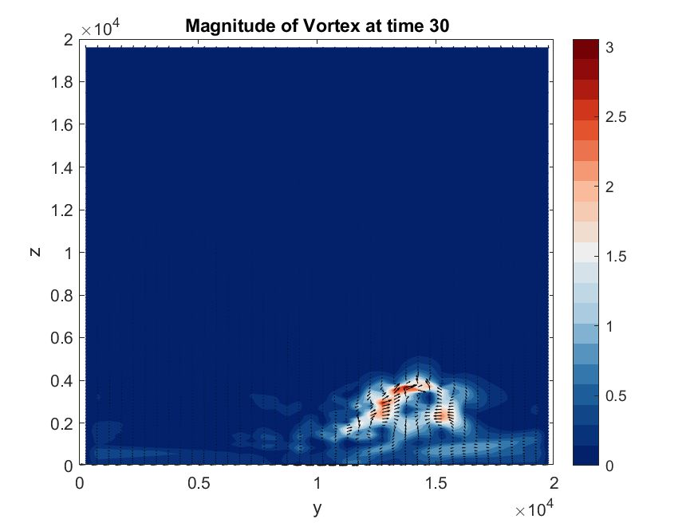
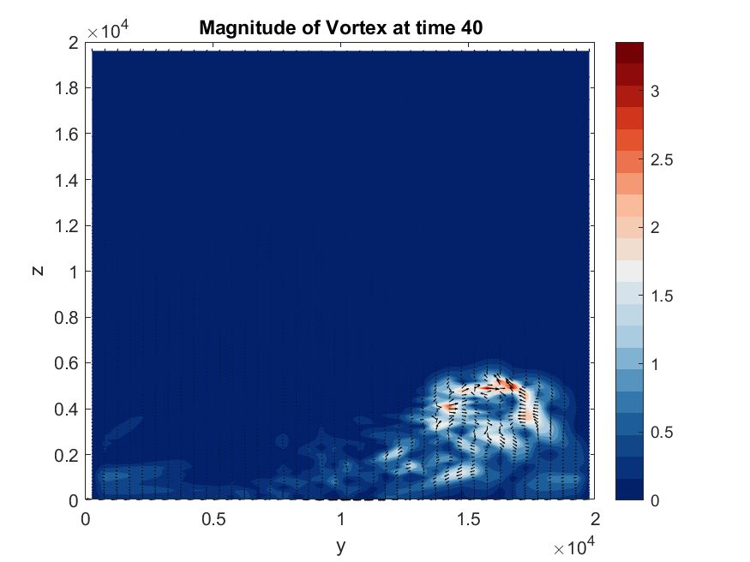
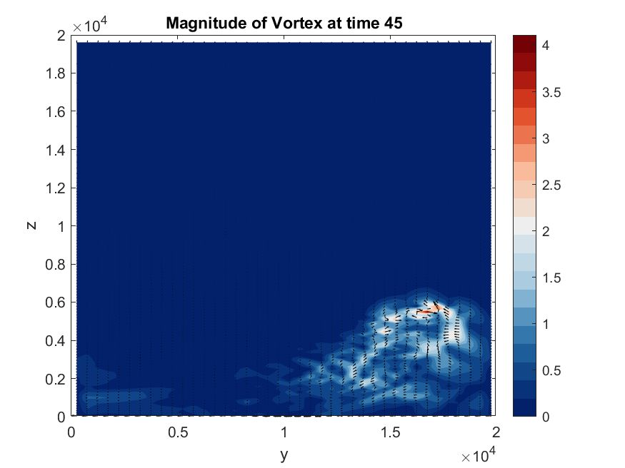
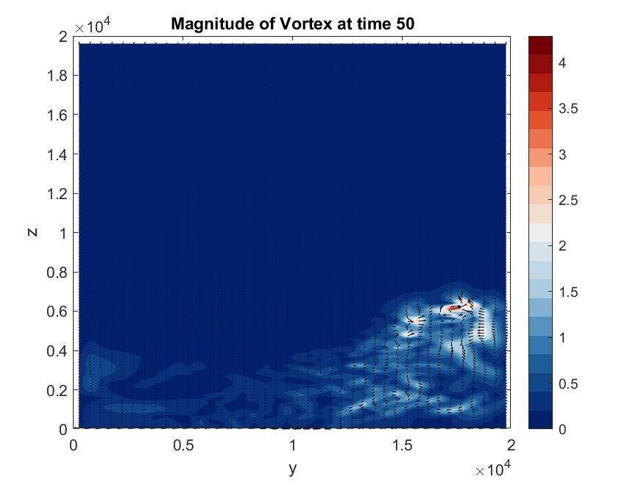
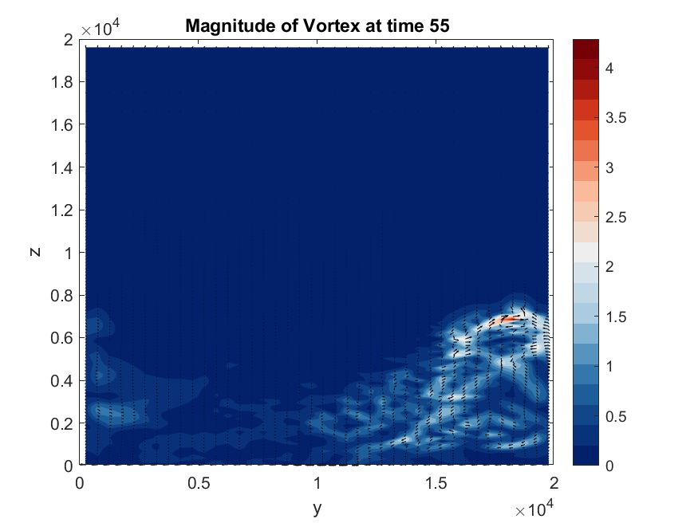
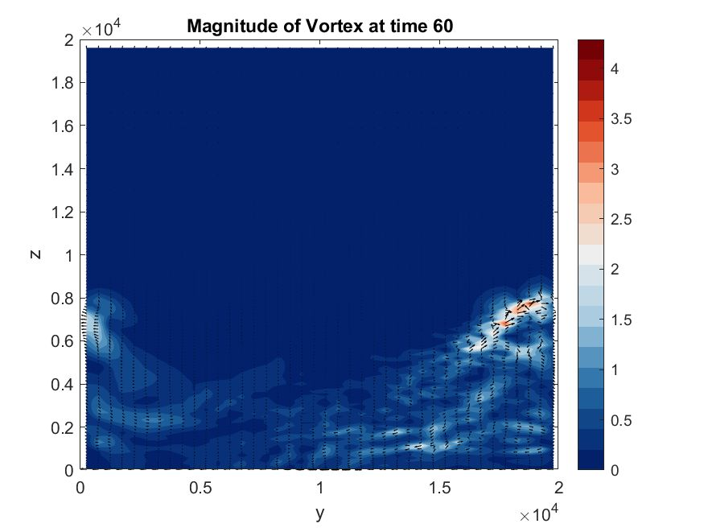
Partially Original Snapshots: Warm Bubble-Like Patterns
Intuitively, a warm-bubble-like pattern goes upward…

Slide 8
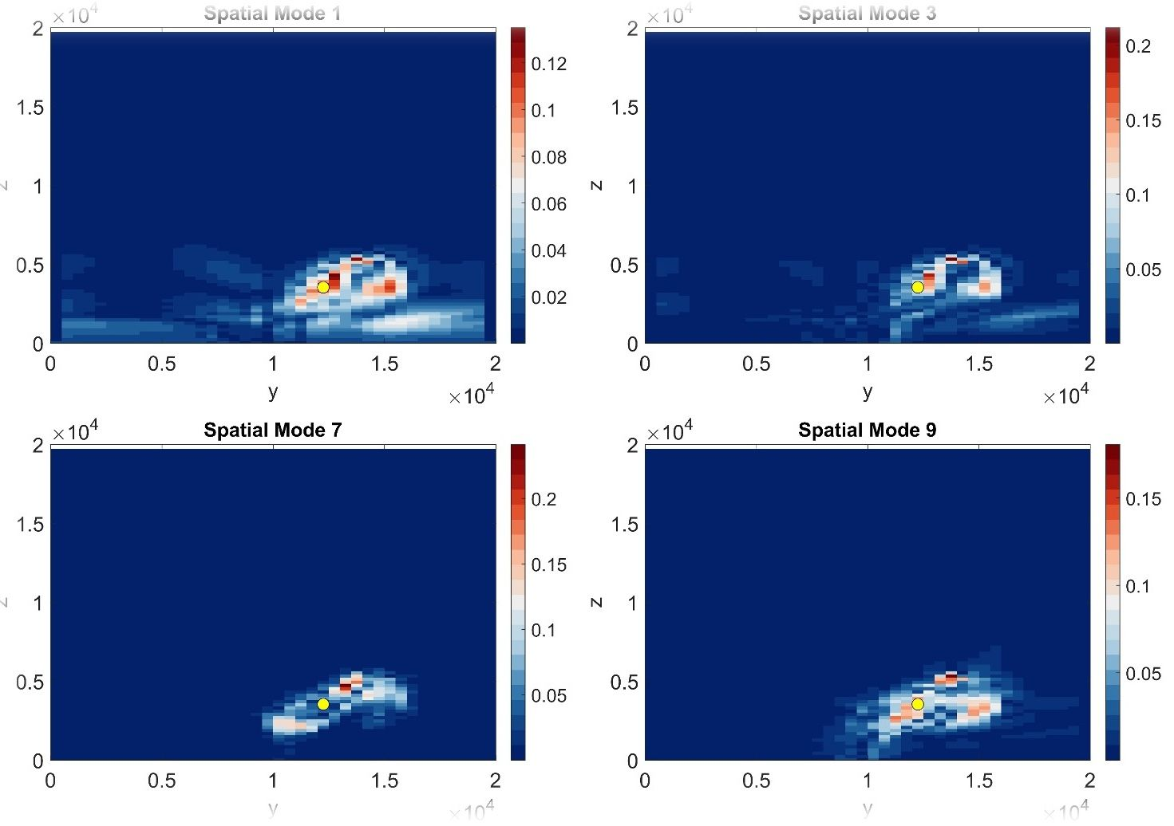
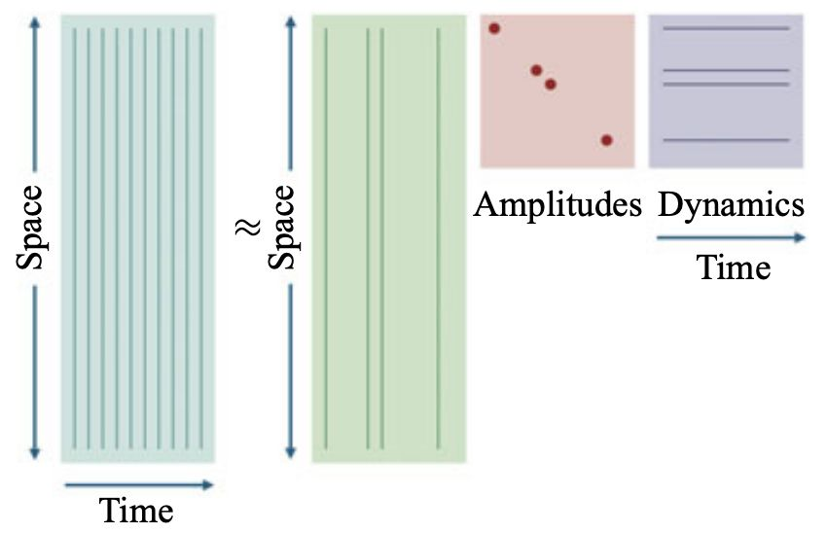
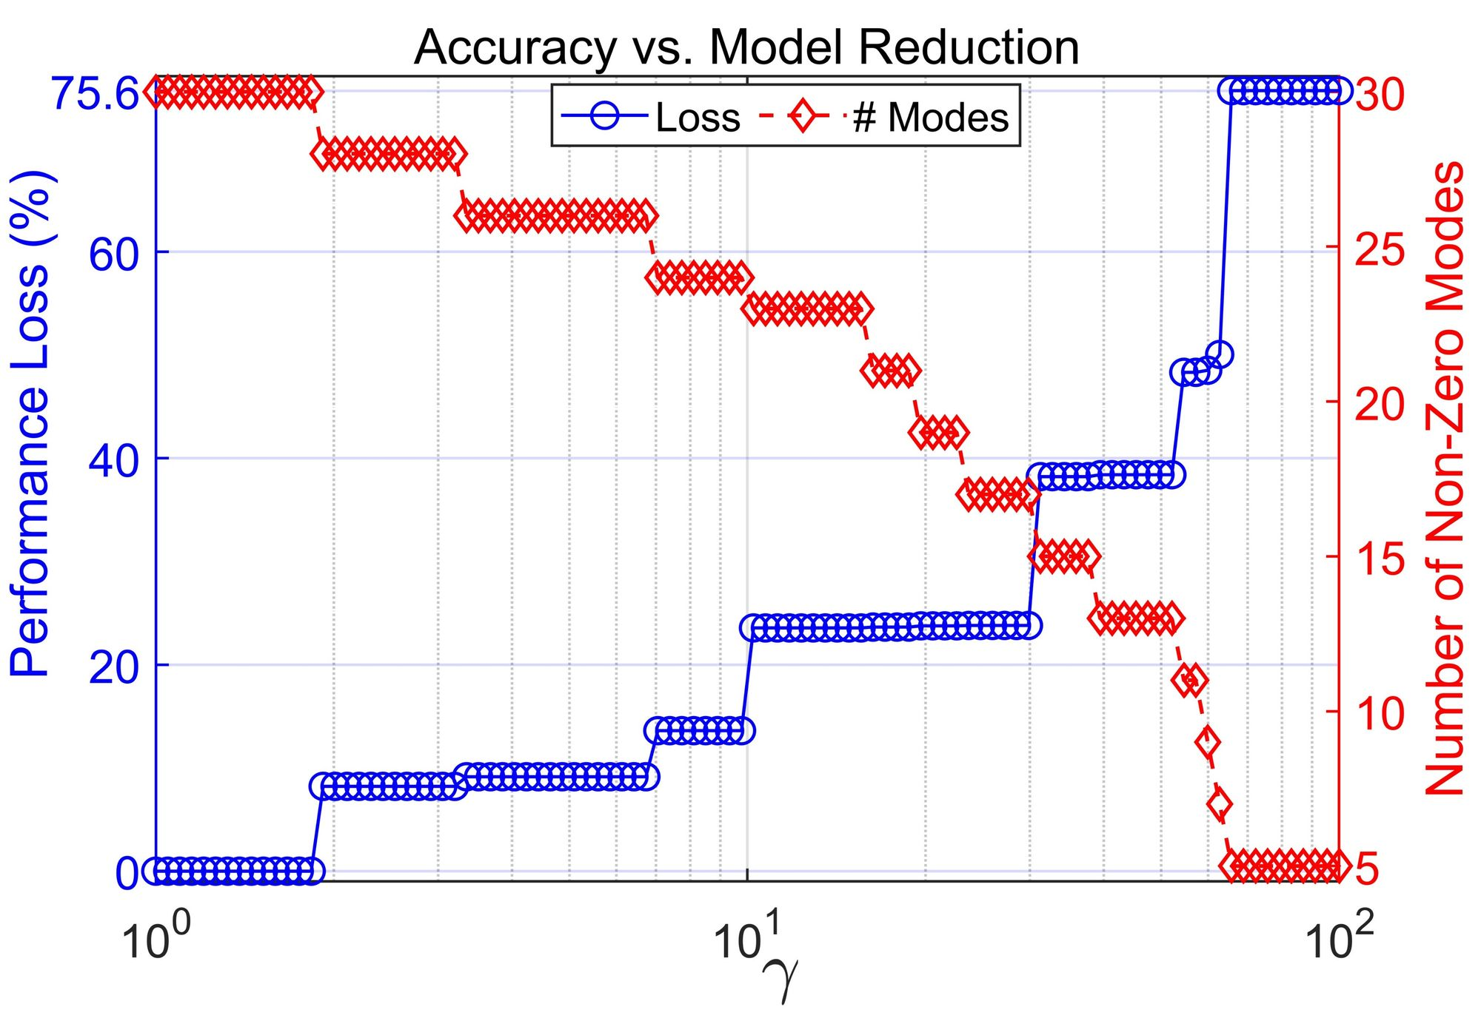
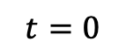
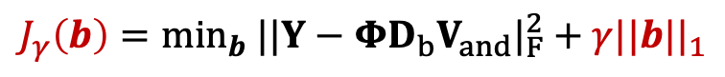
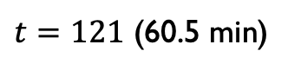
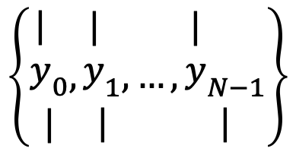
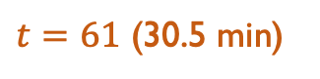
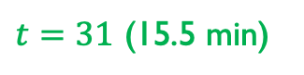
Roadmap of Bubble-like Pattern Extraction
Initial-term
Mid-term
Short-term dynmaics
[.............................]...........................]. ]
$$t=0$$
$t=31$ (15.5 min)
$t=61$ (30.5 min)
$t=121$ (60.5 min)
Sparse
Snapshots
SPDMD
$$\left\{\begin{aligned}{\begin{aligned}| \\ y\end{aligned}}_{0} \\ |\end{aligned},\begin{aligned}{\begin{aligned}| \\ y\end{aligned}}_{1} \\ |\end{aligned},…,\begin{aligned}{\begin{aligned}| \\ y\end{aligned}}_{N−1} \\ |\end{aligned}\right\}$$
$$J_{γ}\left(b\right)=\min_{b} ||Y−ΦD_{b}V_{and}|_{F}^{2}+γ||b||_{1}$$
Balance Accuracy
& Complexity
Ref.) Jovanovic, Schimd & Nichols, Sparsity-promoting dynamic mode decomposition, Physics of Fluids’14

Slide 9
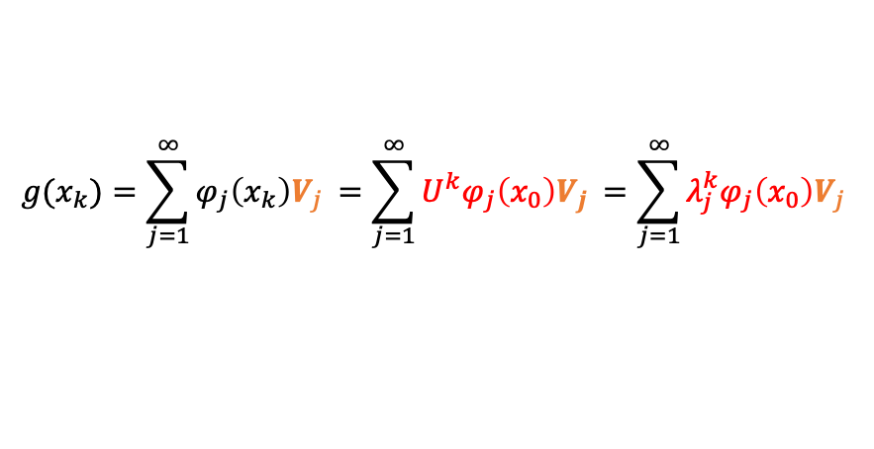
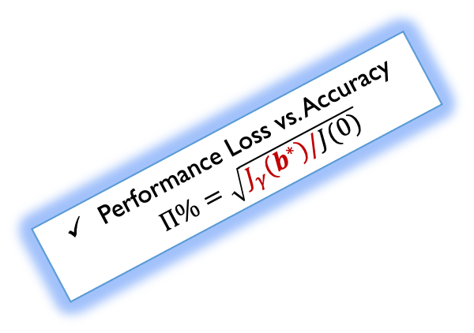


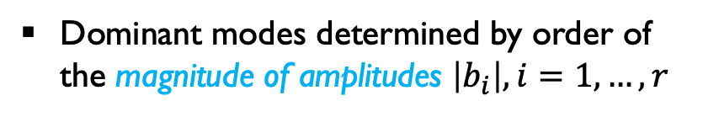
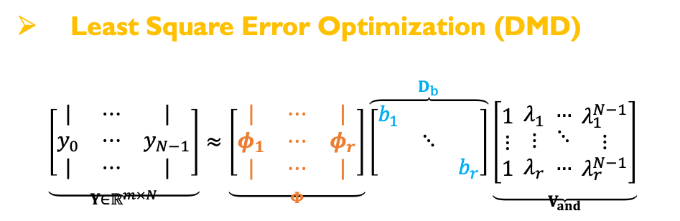

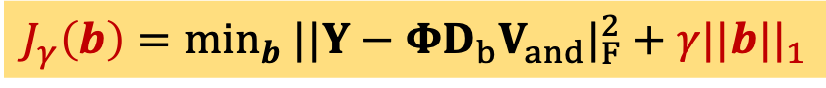
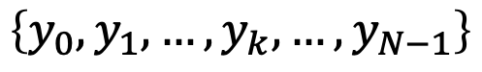
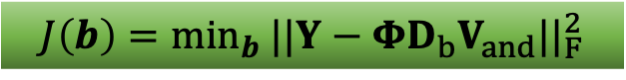

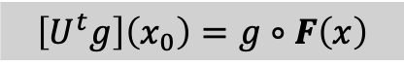
Methods: Koopman and Dynamic Mode Decompositions
Ref.) Mauroy, Mezic & Susuki, The Koopman Operator in Systems and Control, Springer’20
Koopman mode decomposition (KMD)
Dynamic mode decomposition (DMD)
Ref.) J. Kutz, L.Brunton, W..Brunton, & J. Procotor, SIAM’16
$$x_{k+1}=F\left(x_{k}\right),$$
$$y_{k}=g(x_{k})$$
FINITE-LENGTH TIME-SERIES DATA
$$\left\{y_{0},y_{1},…,y_{k},…,y_{N−1}\right\}$$
$$\left[U^{t}g\right]\left(x_{0}\right)=g∘F\left(x\right)$$
$$y_{k}≈\sum_{j=1}^{N}{φ_{j}λ_{j}^{k}b_{j}}$$
SVD
$$y_{k}≈\sum_{j=1}^{r}{φ_{j}λ_{j}^{k}b_{j}}$$
$$g(x_{k})=\sum_{j=1}^{∞}{φ_{j}\left(x_{k}\right)V_{j }}=\sum_{j=1}^{∞}{U^{k}φ_{j}\left(x_{0}\right)V_{j }}=\sum_{j=1}^{∞}{λ_{j}^{k}φ_{j}\left(x_{0}\right)V_{j }}$$
Finite-dim. approximation
$$J\left(b\right)=\min_{b} ||Y−ΦD_{b}V_{and}||_{F}^{2}$$
Sparsity-Promoting DMD: SPDMD
Performance Loss vs. Accuracy $Π\%=\sqrt{J_{γ}(b^{∗})/J(0)}$
Least Square Error Optimization (DMD)
$$\underset{Y∈ℝ^{m×N}}{\underbrace{\left[\begin{matrix}| & ⋯ & | \\ y_{0} & ⋯ & y_{N−1} \\ | & ⋯ & |\end{matrix}\right]}}≈\underset{Φ}{\underbrace{\left[\begin{matrix}| & ⋯ & | \\ φ_{1} & ⋯ & φ_{r} \\ | & ⋯ & |\end{matrix}\right]}}\overset{D_{b}}{\overbrace{\left[\begin{matrix}b_{1} & & \\ & ⋱ & \\ & & b_{r}\end{matrix}\right]}}\underset{V_{and}}{\underbrace{\left[\begin{matrix}1 \\ ⋮ \\ 1\end{matrix} \begin{matrix}λ_{1} \\ ⋮ \\ λ_{r}\end{matrix} \begin{matrix}… \\ ⋱ \\ …\end{matrix} \begin{matrix}λ_{1}^{N−1} \\ ⋮ \\ λ_{r}^{N−1}\end{matrix}\right]}}$$
$$J_{γ}\left(b\right)=\min_{b} ||Y−ΦD_{b}V_{and}|_{F}^{2}+γ||b||_{1}$$
Spatial Modes
Temporal Modes
Dominant modes determined by order of the magnitude of amplitudes $\left|b_{i}\right|, i=1,…,r$
Amplitudes
Penalize an ℓ1 norm on the amplitudes
Ref.) Jovanovic et. al, Physics of Fluids’14

Slide 10
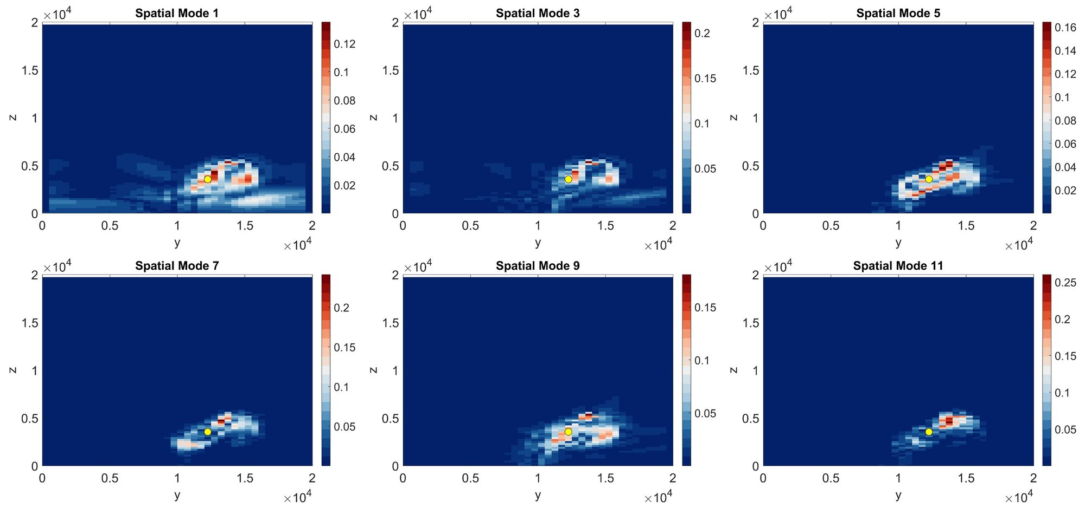
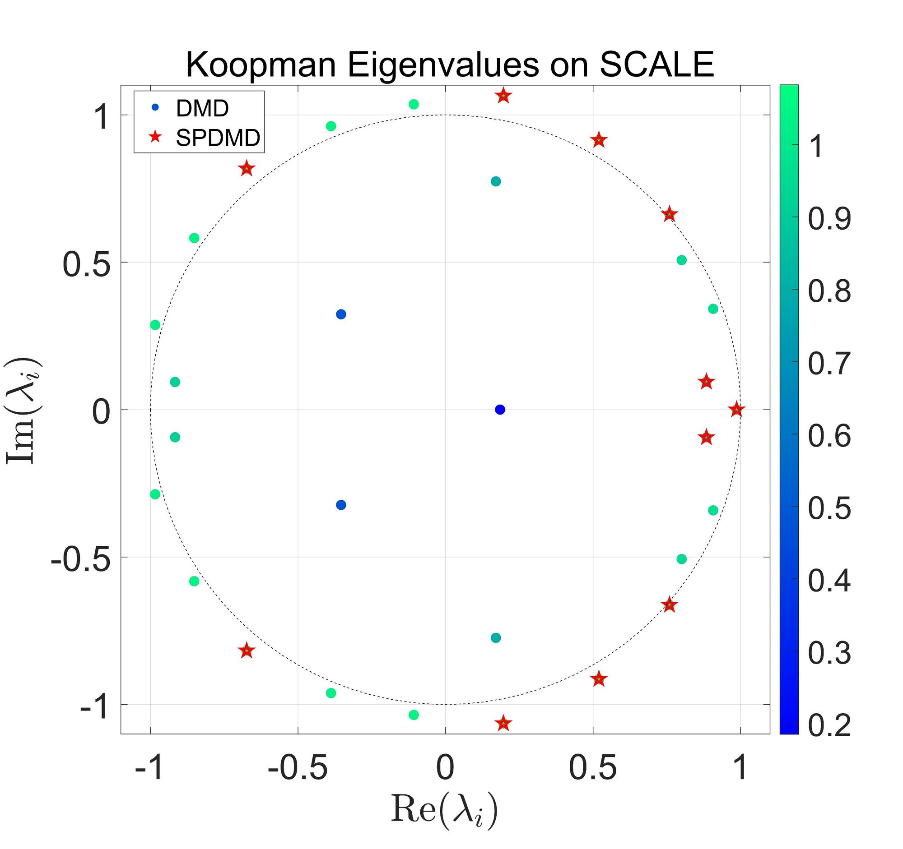
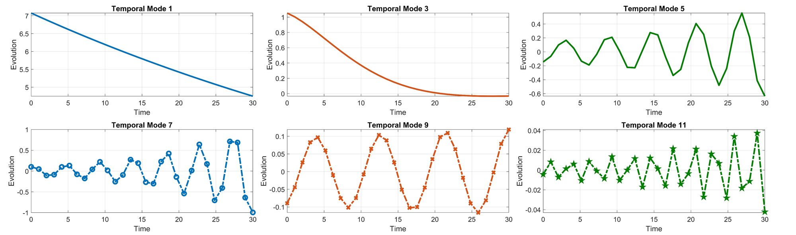
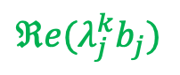
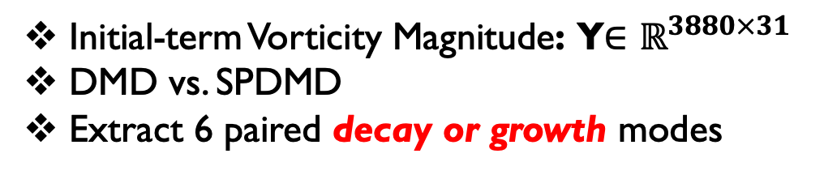

Experiment I: Initial term of Vorticity Magnitude (N=31)
Initial-term Vorticity Magnitude: Y$∈ℝ^{3880×31}$
DMD vs. SPDMD
Extract 6 paired decay or growth modes
$$|φ_{j}|$$
$$ℜe(λ_{j}^{k}b_{j})$$

Slide 11

Performance Assessments:
Superposition evolution
Specific spatial location (25, 26) ≈ (12.5km, 5.4km)
SPDMD makes a trade off between accuracy and model complexity.
However, SPDMD with few selected modes can not directly capture the peak / jump of temporal dynamics (vs. original data)

Slide 12





Experiment 1: Mid-term of Vorticity Magnitude (N=61)
Mid-term Simulation
$$Y∈ℝ^{3880×61}$$
SPDMD
Specific Spatial location (30, 38) ≈ (15km, 7.8km) with the index i=1510 may fail to jump behavior

Slide 13


Performance Loss vs Model Reduction:
SPDMD makes a trade-off between the accuracy and model complexity.
As the sparsity weight increases (1 to 1000),
the number of selected modes decreases (60 to 1) while the performance loss increases (0% to 77.9%).
RMDS comparisons evaluate reconstruction results across all vorticity data points in the y–z plane.
Few selected modes by SPDMD (magenta) cannot fully reconstruct the original data (blue), whereas full-mode DMD (green) can provide better reconstruction.
The sparsity constraint on amplitudes filters sharp peaks, and the lack of a continuous spectrum* might also lead to this effect.
*Refs.) Mezic, Non Dyna’05; Coolbrock & Townsend, CPAM’24

Slide 14





Experiment II: Humidity Ratio Data Field
Goal:
Extract warm bubble-like behavior in weather dynamics
Humidity ratio: Y$∈ℝ^{3880×51}$
Various DMD algorithms
(Companion-DMD*, SPDMD)
Extract 6 pairs leading modes
*Ref.) Rowley et al., JFM’09
Successfully captures a warm-bubble-like rising pattern!

Slide 15
The Take-Home Messages:
Koopman analysis for short-term weather simulation data by using SPDMD method to identify the dominant (spatial & temporal) modes and realize the model reduction.
Experiments on different time-length (initial & mid term duration) and various weather data fields (vorticity magnitude and humidity ratio)
The captured transient modes (growth or decay) reveal warm, bubble-like patterns, suggesting the onset or dissipation of heavy rainfall.

Slide 16

Thank you!
Suggestions and Comments are Welcome!
zhang.zhicheng.2c@kyoto-u.ac.jp

Slide 17
Backup Slides

Slide 18








Weather Dynamics & Observables
Unknown Dynamics
Nonlinear CT/DT dynamical system:
$$x^{+}=F\left(x_{k}\right),$$
$$x∈𝕏⊆ℝ^{n}$$
$$k=0,1,2,…$$
$$F:ℝ^{n}→ℝ^{n}$$
State equation
State/Phase space
Nonlinear map: describes the time evolution of the state, such as the nonlinear weather or climate systems
Output equation
Observable space
$$g:ℝ^{n}→ℝ or ℂ$$
$$y_{k}=g\left(x_{k}\right),$$
$$∀g∈𝒪$$
Observable: the function of the state that can be measured directly from data
E.g., velocity, vorticity, pressure, temperature, humidity ratio fields in weather simulations
Importance: The choice of dictionaries of observable (linear/nonlinear) Open issue!
Hilbert /Banach space
(complete inner product /normed space)
Koopman operator tells us:
$$U^{t}g=g∘F$$

Slide 19


















Koopman Operator: A (Bounded) Linear Operator
Koopman Framework
$$g:ℝ^{n}→ℝ$$
$$ℝ$$
$$ℝ^{n}$$
$$x_{t+1}=F\left(x_{t}\right)$$
$$g∘F^{k}$$
$$x_{k}$$
$$g∘F^{2}$$
$$y_{3}$$
REALIZATION
LIFTING
$$x_{2}$$
$$𝒦^{t}g=g∘F$$
$$g∘F^{1}$$
$$y_{2}$$
$$x_{1}$$
$$x_{0}$$
$$g∘F^{0}$$
$$y_{1}$$
$$g_{t+1}=𝒦^{t}g_{t}=g∘F=g(x_{t+1})$$
State space
(Finite dim. Nonlinear dynamics)
LIFTING
Observable space
(Infinite dim. linear evolution)
Lifts the nonlinear evolution of state into
a linear evolution of functional observable
Linearity: $𝒦^{t}\left(α_{1}g_{1}+α_{2}g_{2}\right)=α_{1}{𝒦^{t}g}_{1}+α_{2}𝒦^{t}g_{2}$
$∀α_{1},α_{2}∈ℝ,{ g}_{1},g_{2}∈𝒪$
Linear operator (Spectral Analysis)
Refs.) Koopman, PNAS’1931; Koopman & von Neumann. PNAS’1932; Mezic, Nonlinear Dynamics’05

